Slide 1
Decomposing the Avalon Healthcare App
Todd Bremner
Microsoft

Slide 2
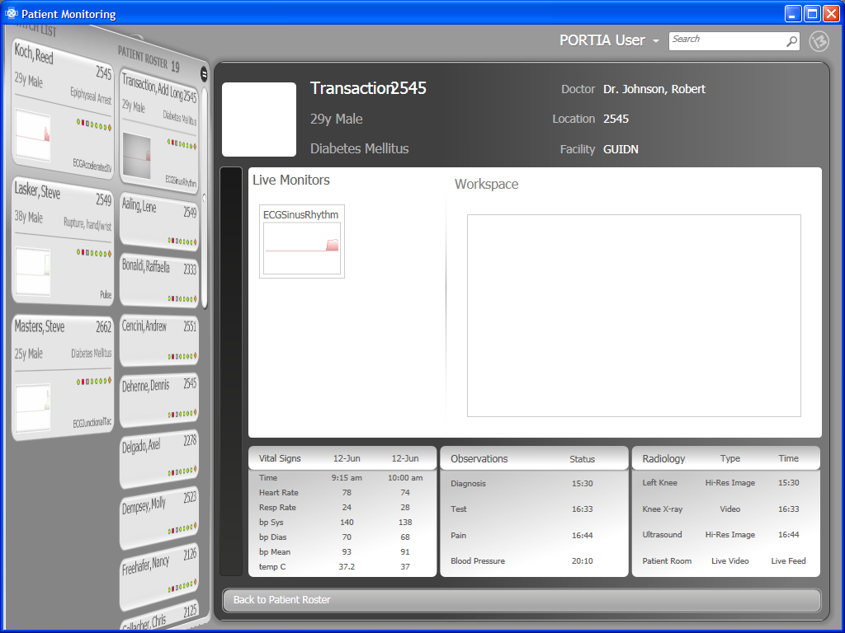
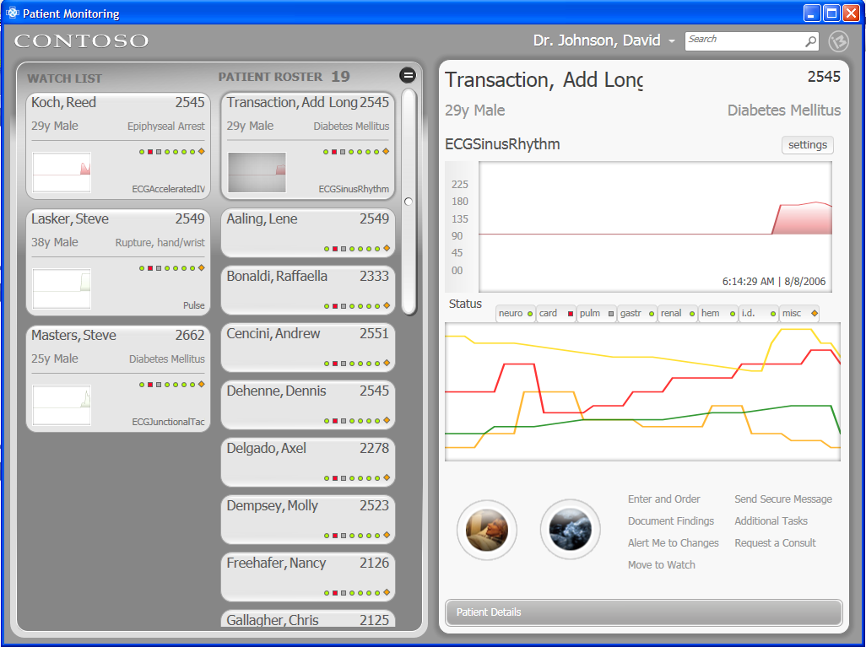
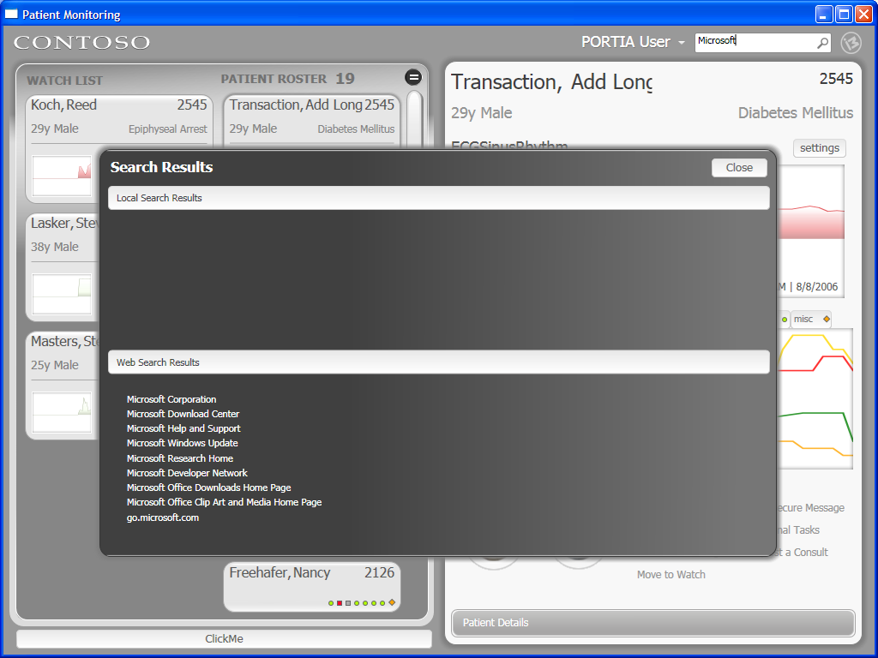
Root Grid Structure
GlobalRoot
<Grid x:Name="GlobalRoot">
Root
Toolbar
Master
Detail
Root : Grid
<Grid.ColumnDefinitions>
<ColumnDefinition Width="250" x:Name="Master3DColumnDefinition" />
<ColumnDefinition Width="0.25*" x:Name="MasterColumnDefinition" />
<ColumnDefinition Width="0.5*" x:Name="DetailColumnDefinition"/>
</Grid.ColumnDefinitions>
<Grid.RowDefinitions>
<RowDefinition Height="30"/>
<RowDefinition Height="*"/>
</Grid.RowDefinitions>
SearchResults

Slide 3
Toolbar Grid
GlobalRoot
Root : Grid
Toolbar
<Grid Name="Toolbar" Background="Transparent" Grid.ColumnSpan="3" Grid.Row="0" >
<Image Source="{StaticResource ContosoHealthcare}" HorizontalAlignment="Left" Margin="7" />
<imPatientHelper:VistaTypeTextBox Style="{StaticResource SearchTextBox}" Button.Click="SearchTextBoxButtonClick" Name="SearchBox" Width="160" Height="Auto" ReturnKeyUp="ReturnKeyUpHandler" d:LayoutOverrides="None" HorizontalAlignment="Right" Margin="0,3,45,3" MinHeight="0"/>
<ComboBox Style="{StaticResource PhysicianSelectorComboBoxStyle}" HorizontalAlignment="Right" SelectedIndex="0" Foreground="white" FontSize="18" FontFamily="Segoe UI" Margin="0,0,210,0">
<ComboBoxItem Content="PORTIA User" />
<ComboBoxItem Content="PORTIA Operator" />
</ComboBox>
<Button HorizontalAlignment="right" Margin="10,2,10,2" VerticalAlignment="Center" Style="{StaticResource LooklessButtonWithHover}" Click="ShowAboutIdentityMineDialog">
<Image Source="{StaticResource IMLogoWhite}" />
</Button>
</Grid>

Slide 4
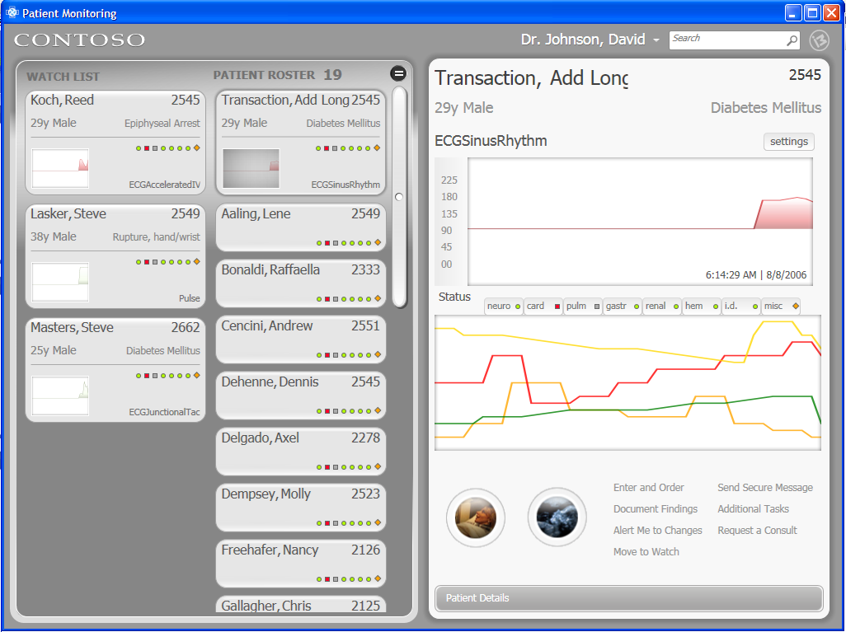
Master Grid Structure
GlobalRoot
Root
Master
<Grid Name="Master" Grid.Row="1" Grid.Column="0" Grid.ColumnSpan="2" Margin="0,0,5,0">
<Grid.RowDefinitions>
<RowDefinition Height="*"/>
</Grid.RowDefinitions>
MasterView2DWrapperFor3DSnap : Grid
<Grid Name="MasterView2DWrapperFor3DSnap" Margin="0,0,0,0" Grid.RowSpan="1">
<Grid.RenderTransform>
<TranslateTransform x:Name="MasterView2DWrapperTranslate" />
</Grid.RenderTransform>
PatientMasterRotater3DTransition : Grid
PatientRosterList3DOverlay : ListBox

Slide 5
Master Grid 3D View Elements
GlobalRoot
Root
Master
PatientMasterRotater3DTransition : Grid
<imRotater3DTransition:Rotater3DTransition Name="PatientMasterRotater3DTransition" DurationTime="0.60" d:IsHidden="true" ScaleX="0.8450" ScaleY="1.0" TranslateX="0.000" TranslateY="0.000" ScaleXTo="0.45" ScaleYTo="1.10" TranslateXTo="-0.33" Visibility="Collapsed" Grid.RowSpan="1" />
PatientRoster3DOverlay : ListBox
<ListBox x:Name="PatientRosterList3DOverlay" Style="{StaticResource LooklessListBox}" SelectionChanged="OnPatientRoster3DOverlaySelectionChanged" IsSynchronizedWithCurrentItem="True" DataContext="{Binding Source={StaticResource HealthDataXML}, XPath=/healthFirst/patients/patient}" ItemsSource="{Binding}" ItemContainerStyle="{StaticResource RosterListItem}" Opacity="0.0" Visibility="Collapsed" Grid.RowSpan="1">
<ListBox.RenderTransform>
<TransformGroup>
<ScaleTransform ScaleX="0.22" ScaleY="1.1" />
<SkewTransform CenterX="0" CenterY="0" AngleX="0" AngleY="-5" />
<TranslateTransform X="135" Y="20" />
</TransformGroup>
</ListBox.RenderTransform>
</ListBox>

Slide 6
MasterView2D Grid
GlobalRoot
Root
Master
MasterView2DWrapperFor3DSnap : Grid
<Grid Name="MasterView2DWrapperFor3DSnap" Margin="0,0,0,0" Grid.RowSpan="1">
<Grid.RenderTransform>
<TranslateTransform x:Name="MasterView2DWrapperTranslate" />
</Grid.RenderTransform>
MasterView2D
<Grid x:Name="MasterView2D" Margin="0,0,0,0">
<Grid.ColumnDefinitions>
<ColumnDefinition x:Name="WatchlistColumnDefinition" />
<ColumnDefinition x:Name="PatientRosterColumnDefinition" />
</Grid.ColumnDefinitions>
<Grid.RowDefinitions>
<RowDefinition Height="*"/>
<RowDefinition Height="Auto"/>
</Grid.RowDefinitions>

Slide 7
WatchList Column
GlobalRoot
Root
Master
MasterView2DWrapperFor3DSnap
WatchListHeaderContent: ContentControl
<ContentControl x:Name="WatchListHeaderContent" Grid.Column="0" Grid.Row="0" Template="{StaticResource WatchListHeaderTemplate}" VerticalAlignment="Top" Margin="22,10,0,0" Height="39" Grid.RowSpan="1" HorizontalAlignment="Left" Width="93.88" />
MasterView2D
WatchList : ListBox
<ListBox x:Name="WatchList" Grid.Column="0" Grid.Row="0" Style="{StaticResource LooklessListBox}" DataContext="{Binding Source={StaticResource WLHealthDataXML}, XPath=/healthFirst/patients/patient}" ItemsSource="{Binding}" ItemContainerStyle="{StaticResource WatchListItem}" Margin="17,40,0,0" />

Slide 8
PatientRosterListColumn
GlobalRoot
Root
Master
MasterView2DWrapperFor3DSnap
MasterView2D
PatientRosterListHeaderContent: ContentControl
<ContentControl x:Name="PatientRosterListHeaderContent" Grid.Column="1" Grid.Row="0" Template="{StaticResource PatientRosterListHeaderTemplate}" VerticalAlignment="Top" Margin="2.8421709430404E-14,10,-5.6843418860808E-14,0" Height="35" Grid.RowSpan="1" Grid.ColumnSpan="1" />
PatientRosterStyleSelectorContent : ContentControl
<ContentControl x:Name="PatientRosterStyleSelectorContent" Grid.Column="1" Grid.Row="0" HorizontalAlignment="Right" VerticalAlignment="Top" Template="{StaticResource PatientRosterStyleSelectorTemplate}" Height="30" d:LayoutOverrides="HorizontalAlignment, VerticalAlignment" Margin="0,10,5,0" Width="37" Grid.RowSpan="1" />
PatientRosterList : ListBox
<ListBox x:Name="PatientRosterList" Grid.Column="1" Grid.Row="0" ClipToBounds="False" Style="{StaticResource LooklessListBox}" SelectionChanged="OnPatientRosterSelectionChanged" IsSynchronizedWithCurrentItem="True" DataContext="{Binding Source={StaticResource HealthDataXML}, XPath=/healthFirst/patients/patient}" ItemsSource="{Binding}" ItemContainerStyle="{StaticResource RosterListItem}" Margin="2.8421709430404E-14,40,12,15" />

Slide 9
Detail Grid
GlobalRoot
Root
Detail : Grid
<Grid Name="Detail" Grid.Row="1" Grid.Column="2" Margin="0,0,0,0" Grid.ColumnSpan="1" >
DetailFront2DWrapper : Grid
<Grid Name="DetailFront2DWrapper" d:IsHidden="True">
<Grid.RenderTransform>
<TranslateTransform x:Name="DetailFront2DWrapperTranslate" />
</Grid.RenderTransform>
DetailBack2DWrapper : Grid
<Grid Name="DetailBack2DWrapper">
<Grid.RenderTransform>
<TranslateTransform x:Name="DetailBack2DWrapperTranslate" />
</Grid.RenderTransform>

Slide 10
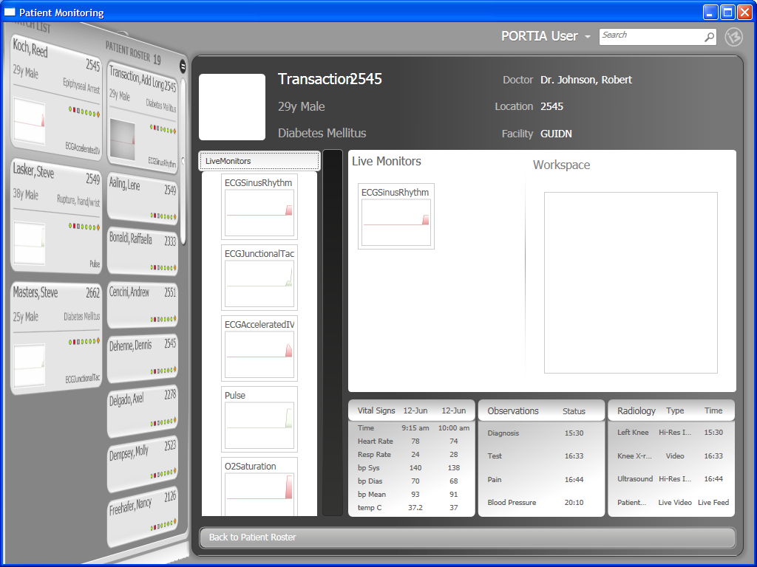
DetailBack2DWrapper Grid
GlobalRoot
Root
Detail
DetailBack2DWrapper : Grid
<Grid Name="DetailBack2DWrapper">
<Grid.RenderTransform>
<TranslateTransform x:Name="DetailBack2DWrapperTranslate" />
</Grid.RenderTransform>
PatientDetails : Grid
<Grid x:Name="PatientDetails" Margin="0,15,9,0">
<Grid.RowDefinitions>
<RowDefinition Height="120" />
<RowDefinition Height="0.6639381270903*" />
<RowDefinition Height="0.3360618729097*" />
<RowDefinition Height="53"/>
</Grid.RowDefinitions>
<Grid.ColumnDefinitions>
<ColumnDefinition Width="Auto"/>
<ColumnDefinition Width="245"/>
<ColumnDefinition Width="*"/>
</Grid.ColumnDefinitions>
DetailBack2D : Grid
<Grid Name="DetailBack2D" Margin="0,0,0,0" >
<ContentControl Template="{StaticResource DetailBackgroundTemplate}" HorizontalAlignment="Stretch" VerticalAlignment="Stretch" Margin="-7,0,0,-4" Width="Auto" Height="Auto" x:Name="DetailBackgroundContent" Content="ContentControl" d:LayoutOverrides="HorizontalAlignment, VerticalAlignment"/>

Slide 11
DetailBack2DWrapper Grid
GlobalRoot
Root
PatientDetails : Grid
Detail
DetailBack2DWrapper
PatientDetailHeaderContent : ContentControl
<ContentControl x:Name="PatientDetailHeaderContent" Grid.Row="0" Content="{Binding SelectedItem, ElementName=PatientRosterList}" ContentTemplate="{StaticResource PatientDetailHeaderTemplate}" Margin="0,10,10,0" Grid.ColumnSpan="3" />
DetailBack2D
PatientDetailLiveMonitorsContent : ContentControl
<ContentControl x:Name="PatientDetailLiveMonitorsContent" Grid.Row="1" HorizontalAlignment="Stretch" Template="{StaticResource PatientDetailLiveMonitorsTemplate}" Margin="10,10,5,10" Grid.RowSpan="1" Grid.Column="1" Width="Auto" d:LayoutOverrides="HorizontalAlignment" />
PatientDetailWorkspaceContent : ContentControl
<ContentControl x:Name="PatientDetailWorkspaceContent" Grid.Row="1" HorizontalAlignment="Stretch" Template="{StaticResource PatientDetailWorkspaceTemplate}" d:LayoutOverrides="None" Margin="5,10,15,10" Width="Auto" Grid.RowSpan="1" Grid.Column="2" />
PatientDetailSelectorContent : ContentControl
<ContentControl x:Name="PatientDetailSelectorContent" Grid.Row="1" Grid.RowSpan="2" HorizontalAlignment="Stretch" Template="{StaticResource PatientDetailSelectorTemplate}" Margin="5,2.8421709430404E-14,0,5" d:LayoutOverrides="Width" />
PatientDetailDataGridContent : ContentControl
<ContentControl x:Name="PatientDetailDataGridContent" Grid.Row="2" HorizontalAlignment="Stretch" Template="{StaticResource PatientDetailDataGridTemplate}" Margin="3,3,10,4" Width="Auto" Grid.RowSpan="1" Grid.Column="1" Grid.ColumnSpan="2" />
BackToPatientOverview : Button
<Button x:Name="BackToPatientOverview" Content="Back to Patient Roster" Style="{DynamicResource pdButtonStyle}" Grid.Row="3" Click="OnBackToPatientOverview" VerticalAlignment="Center" Margin="10,0,10,8" Height="30" Grid.ColumnSpan="3"/>

Slide 12
DetailFront2DWrapper Grid
GlobalRoot
Root
Detail
DetailFront2DWrapper : Grid
<Grid Name="DetailFront2DWrapper" d:IsHidden="True">
<Grid.RenderTransform>
<TranslateTransform x:Name="DetailFront2DWrapperTranslate" />
</Grid.RenderTransform>
DetailFront2D : Grid
<Grid Name="DetailFront2D" Grid.Column="1" Margin="5,-3,0,-3" Visibility="Visible">
PatientOverview2D : Grid
<Grid x:Name="PatientOverview2D" Margin="0,0,0,0" >
<Grid.RowDefinitions>
<RowDefinition Height="100"/>
<RowDefinition Height="*"/>
<RowDefinition Height="200"/>
<RowDefinition Height="151" />
<RowDefinition Height="63" />
</Grid.RowDefinitions>

Slide 13
PatientOverview2D Grid
GlobalRoot
Root
PatientOverview2D
Detail
PatientOverviewHeaderBackgroundContent : ContentControl
<ContentControl x:Name="PatientOverviewHeaderBackgroundContent" Grid.Row="0" Grid.RowSpan="5" Template="{StaticResource PatientOverviewHeaderBackgroundTemplate}" Margin="-5,0,0,0" />
DetailFront2DWrapper
DetailFront2D
PatientOverviewHeaderContent : ContentControl
<ContentControl x:Name="PatientOverviewHeaderContent" Grid.Row="0" Content="{Binding SelectedItem, ElementName=PatientRosterList}" ContentTemplate="{StaticResource PatientOverviewHeaderTemplate}" Margin="10,20,20,0" />
PatientOverviewChartContent : ContentControl
<ContentControl x:Name="PatientOverviewChartContent" Grid.Row="1" Content="{Binding SelectedItem, ElementName=PatientRosterList}" ContentTemplate="{StaticResource PatientOverviewChartTemplate}" Margin="0,0,10,0" />
PatientOverviewStatusContent : ContentControl
<ContentControl x:Name="PatientOverviewStatusContent" Grid.Row="2" Template="{StaticResource PatientOverviewStatusTemplate}" Margin="10,0,20,0" />
PatientOverviewPreviewContent : ContentControl
<ContentControl x:Name="PatientOverviewPreviewContent" Grid.Row="3" HorizontalAlignment="Left" Template="{StaticResource PatientOverviewPreviewTemplate}" Margin="9,26,0,18" Width="199.66" Grid.RowSpan="1" />
PatientOverviewTaskListContent : ContentControl
<ContentControl x:Name="PatientOverviewTaskListContent" Grid.Row="3" HorizontalAlignment="Stretch" Template="{StaticResource PatientOverviewTaskListTemplate}" Margin="226.14,37,19.9999999999999,73" Width="Auto" Grid.RowSpan="2" />
PatientDetailButton : Button
<Button Style="{DynamicResource pdButtonStyle}" Grid.Row="4" Content="Patient Details" x:Name="PatientDetailButton" Click="OnPatientDetailButton" Margin="10,0,16.9999999999998,18" VerticalAlignment="Bottom" Height="33" />

Slide 14
Search Results Grid
GlobalRoot
Root : Grid
Grid : Grid
<Grid HorizontalAlignment="Stretch" VerticalAlignment="Stretch" Margin="100,100,100,100" x:Name="Grid">
<ContentControl Template="{StaticResource DetailBackgroundTemplate}" />
<DockPanel LastChildFill="True" Margin="10,45,10,20">
<Expander x:Name ="MSNExpander" Template="{StaticResource PatientDetailsExpander}" IsExpanded="True" DockPanel.Dock="Bottom" Header="Web Search Results" Margin="5">
<ListBox x:Name="PatientMSNSearchList" Margin="20" DataContext="{Binding SearchMSNData, Source={StaticResource SearchDataResults}}" ItemsSource="{Binding}" ItemContainerStyle="{StaticResource SearchListItem}" SelectionChanged="PatientMSNSearchList_SelectionChanged" Style="{DynamicResource LooklessListBox}" Background="{x:Null}" BorderBrush="{x:Null}" />
</Expander>
<Expander x:Name ="LocalExpander" Template="{StaticResource PatientDetailsExpander}" IsExpanded="True" Header="Local Search Results" Margin="5">
<ListBox x:Name="PatientLocalSearchList" Margin="20" DataContext="{Binding SearchXPSData, Source={StaticResource SearchDataResults}}" ItemsSource="{Binding}" ItemContainerStyle="{StaticResource SearchListItem}" SelectionChanged="PatientLocalSearchList_SelectionChanged" Style="{DynamicResource LooklessListBox}" Background="{x:Null}" BorderBrush="{x:Null}" />
</Expander>
</DockPanel>
<Button x:Name="PatientSearchCloseButton" Content="Close" Click="PatientSearchCloseButton_Click" d:LayoutOverrides="Height" HorizontalAlignment="Right" VerticalAlignment="Top" Margin="0,20,20,0" Width="65" />
<TextBlock FontSize="16" FontWeight="Bold" HorizontalAlignment="Left" VerticalAlignment="Top" Margin="20,20,0,0" Width="166" Height="25" x:Name="TextBlock" Foreground="#FFFFFFFF" Text="Search Results" TextWrapping="Wrap"/>
</Grid>
PatientSearchResults : Grid
<Grid Name="PatientSearchResults" Background="{x:Null}" Grid.Row="1" Grid.Column="0" Width="Auto" Height="Auto" Visibility="Collapsed" Grid.RowSpan="1" Grid.ColumnSpan="3">

Slide 15
Source Original Views

Slide 16
Main View Default

Slide 17
Flipped View Default

Slide 18
Flipped View Expanded

Slide 19
Search Results View

Slide 20
Front App Grid Structure
GlobalRoot
Root
Toolbar
<Grid Name="Toolbar" Background="Transparent" Grid.ColumnSpan="3" Grid.Row="0" >
Master
<Grid Name="Master" Grid.Row="1" Grid.Column="0" Grid.ColumnSpan="2" Margin="0,0,5,0">
<Grid.RowDefinitions>
<RowDefinition Height="*"/>
</Grid.RowDefinitions>
Detail
<Grid Name="Detail" Grid.Row="1" Grid.Column="2" Margin="0,0,0,0" Grid.ColumnSpan="1" >

